Slide 1


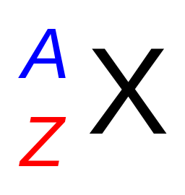
Atomic Number, Mass Number, and Isotopes
2.3
Atoms are identified by the number of protons and neutrons
Atomic number (Z) is that of protons in the nucleus.
As atoms are neutral, the number of electrons also equals Z.
Protons determine the element identity.
E.g., the atomic number of N is 7, so every N atom has 7 protons.
Mass number (A) is the total number of protons and neutrons
(collectively nucleons).
Mass number
(number of nucleons)
Elemental
symbol
Atomic number
(number of protons)
This atom identification is NOT unique in general.
Nuclear isomers differ by the geometry (shape),
have distinct properties. Some stable for a long time.
Denoted Am in the superscript

Slide 2
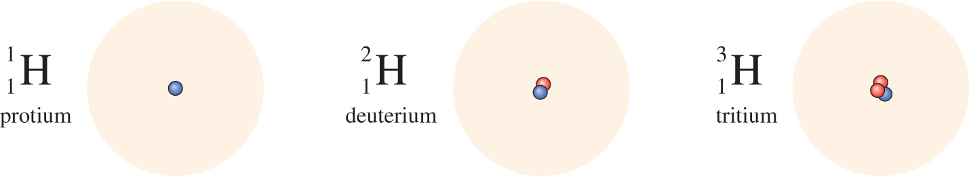
Atomic Number, Mass Number, and Isotopes
Most elements have two or more isotopes: atoms that have the same atomic number (Z) but different mass numbers (A).
1 proton
0 neutrons
1 proton
1 neutron
1 proton
2 neutrons
Isotopes of same element exhibit similar chemical properties, forming the same types of compounds and displaying similar reactivities (slight kinetic variations possible due to small geometry differences and mass effects).

Slide 3
Example 2.1
Determine the numbers of protons, neutrons, and electrons in these species: (a) Cl, (b) Cl, (c) K, (d) carbon-14
35
17
37
41
Strategy Again: the superscript denotes the mass number (A) and the subscript denotes the atomic number (Z). Without subscript, the atomic number can be deduced from the element symbol. Atoms are neutral, so the number of electrons equals that of protons.
Solution
Z = 17, so 17 protons
A = 35, so 35 - 17 = 18 neutrons
# of electrons = # of protons, so 17 electrons
Element is chlorine again, so Z must be 17; hence 17 protons
A = 37, so 37 - 17 = 20 neutrons
17 protons, so 17 electrons

Slide 4
Example 2.1 (cont.)
Solution
(c) Potassium atomic number is 19, so 19 protons
A = 41, so 41 - 19 = 22 neutrons
# of electrons = # of protons, so 19 electrons
Solution
(d) Carbon-14 can also be represented as C
The atomic number is 6, so 6 protons
A = 14, so 14 - 6 = 8 neutrons
6 protons, so 6 electrons
14
Check your results
Verify that the numbers of protons and neutrons sum to the given mass number.
(a): 17 protons and 18 neutrons sum to the stated mass number of 35.
(b): 17 protons + 20 neutrons = 37
(c): 19 protons + 22 neutrons = 41
(d): 6 protons + 8 neutrons = 14

Slide 5

Average Atomic Mass
2.5
Atomic mass is the mass of an atom in atomic mass units (amu).
1 amu = 1/12 the mass of ¹²C atom
The average atomic mass in the periodic table represents the average mass of the natural isotopic mixture.
Average mass (C) = (0.9893)(12.00000 amu) + (0.0107)(13.003355 amu)
Isotope | Isotopic mass (amu) | Natural abundance (%)
¹²C | 12.00000 | 98.93
¹³C | 13.003355 | 1.07
= 12.01 amu

Slide 6
Example 2.2
Oxygen is the most abundant element in both Earth’s crust and the human body. The atomic masses of its three stable isotopes, O (99.757 percent), O (0.038 percent), O (0.205 percent), are 15.9949, 16.9991, and 17.9992 amu. Calculate the average atomic mass of O using these relative abundances.
16
8
17
8
18
8
Strategy
Each isotope contributes to the average atomic mass in proportion to abundance. Multiplying the mass of each isotope by its fractional abundance (percent value divided by 100) gives its contribution to the average mass.
Solution
(0.99757)(15.9949 amu) + (0.00038)(16.9991 amu) + (0.00205)(17.992 amu)
= 15.9994 amu
Check your results The average atomic mass should be closest to the mass
of most abundant isotope (here, ¹⁶O) and, to four significant figures,
equal the number in the periodic table (here, 16.00 amu).

Slide 7
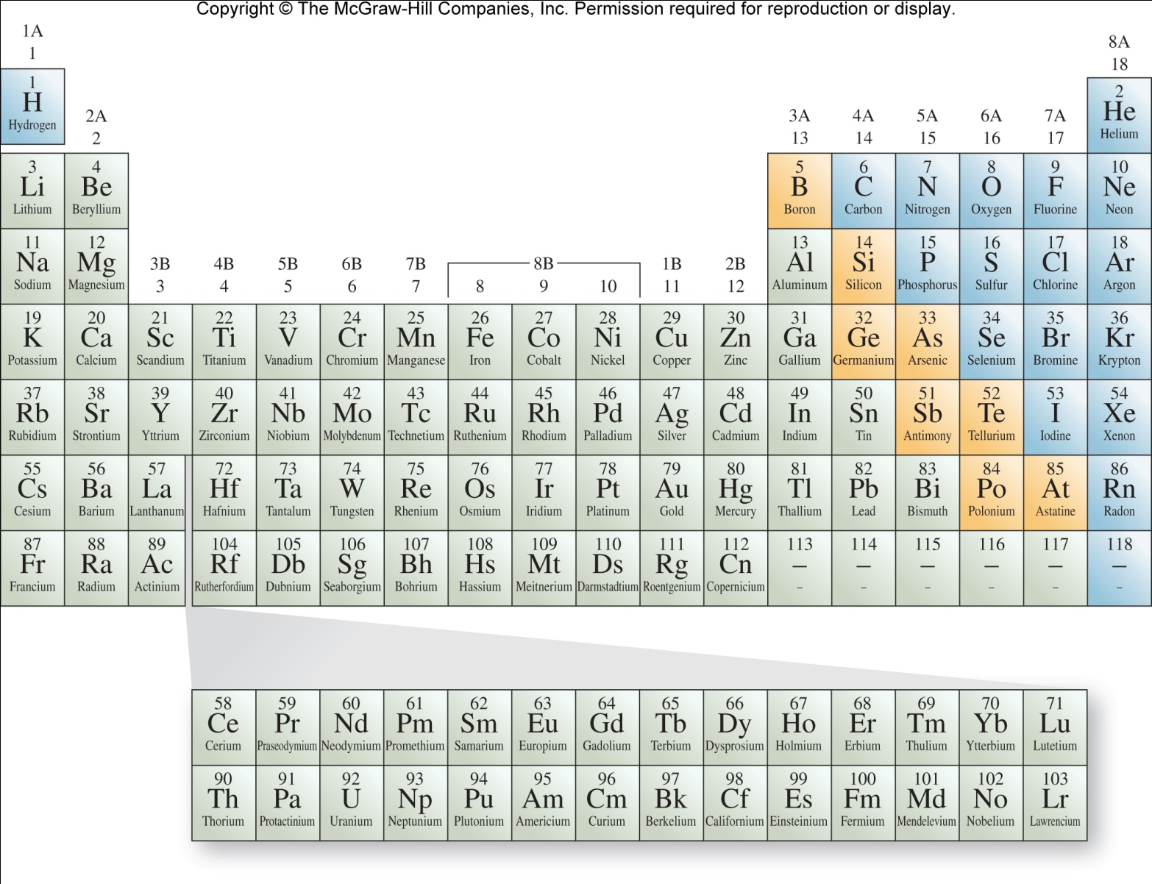
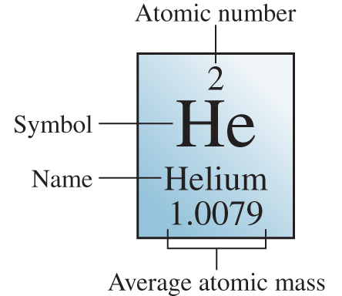
Periodic Table
2.6
Periodic table is a chart grouping the elements
with similar chemical and physical properties.

Slide 8
Periodic Table
Elements are arranged in periods (horizontal rows) in the order of increasing atomic number.

Slide 9

Periodic Table
Elements are categorized as metals, nonmetals, or metalloids
Metals are good conductors
of heat and electricity.
Nonmetals are poor
conductors of heat or
electricity.
Metalloids have
intermediate properties.

Slide 10
Periodic Table
A vertical column is known as a group

Slide 11
Periodic Table
Group 1A elements (Li, Na, K, Rb, Cs, Fr) are alkali metals

Slide 12
Periodic Table
Group 2A elements (Be, Mg, Ca, Sr, Ba, Ra) are alkaline earth metals

Slide 13
Periodic Table
Group 6A elements (O, S, Se, Te, Po) are chalcogens

Slide 14
Periodic Table
Group 7A elements (F, Cl, Br, I, At) are halogens

Slide 15
Periodic Table
Group 8A elements (He, Ne, Ar, Kr, Xe, Rn) are noble gases

Slide 16
Periodic Table
Groups 1B and 3B-8B are transition elements or transition metals.

Slide 17
Subatomic Particles and Atomic Structure
Wilhelm Rontgen (1845-1923) discovered X-rays.
They were not deflected by magnetic or electric fields,
so could not consist of charged particles.
Antoine Becquerel (1852-1908) discovered radioactivity - spontaneous emission of radiation.
Radioactive substances, such as uranium,
can produce three types of radiation.

Slide 18
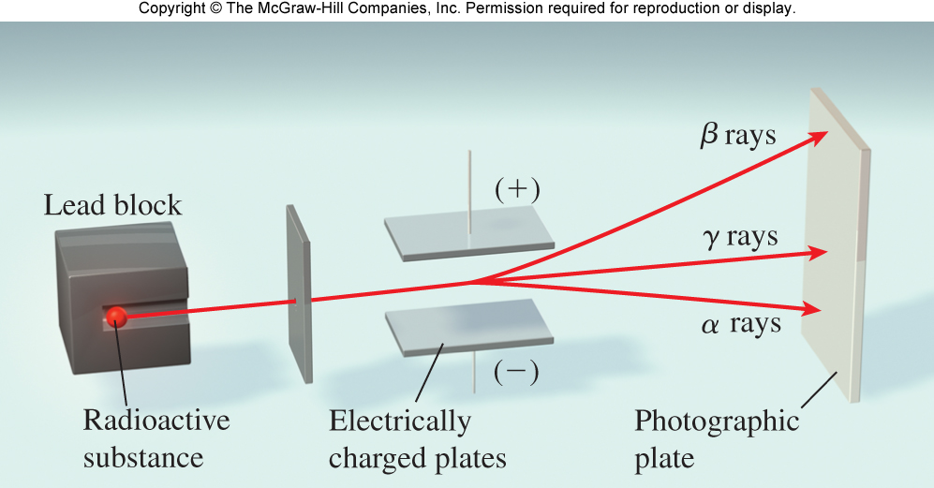
Subatomic Particles and Atomic Structure
Alpha (α) rays consist of positively charged particles, called α particles (He nuclei).
Beta (β) rays, or β particles, are electrons.
They are deflected away from the negatively charged plate.
Gamma (γ) rays, like X-rays, have no charge and are unaffected by electric or magnetic fields.

Slide 19


Mole and Molar Mass
2.6
A mole is the amount of substance that contains as many elementary entities as there are atoms in 12 g of carbon-12.
This experimental number is Avogadro’s number (N_{A}).
(normally rounded to 6.022×10²³)
1 mole = 6.022×10²³, just like 1 dozen = 12
N_{A} = 6.0221415 x 10²³

Slide 20
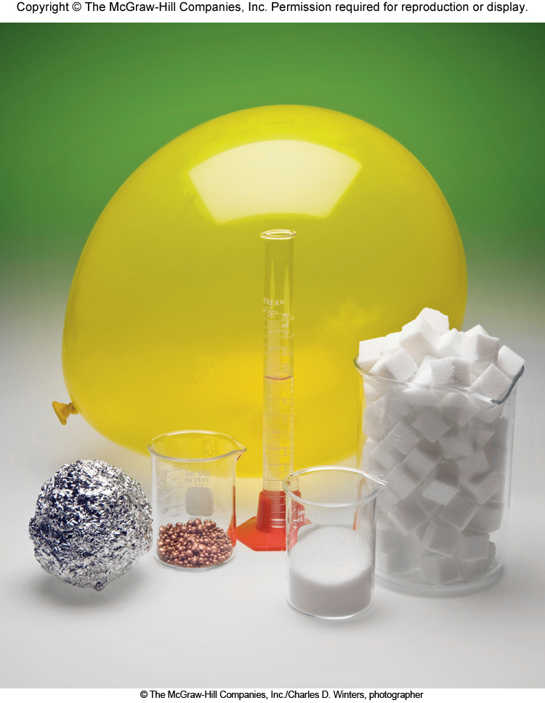
The Mole
One mole each of common substances
Helium (in balloon)
Water
Sugar (Sucrose)
Aluminum
Copper
Salt (NaCl)

